Slide 1
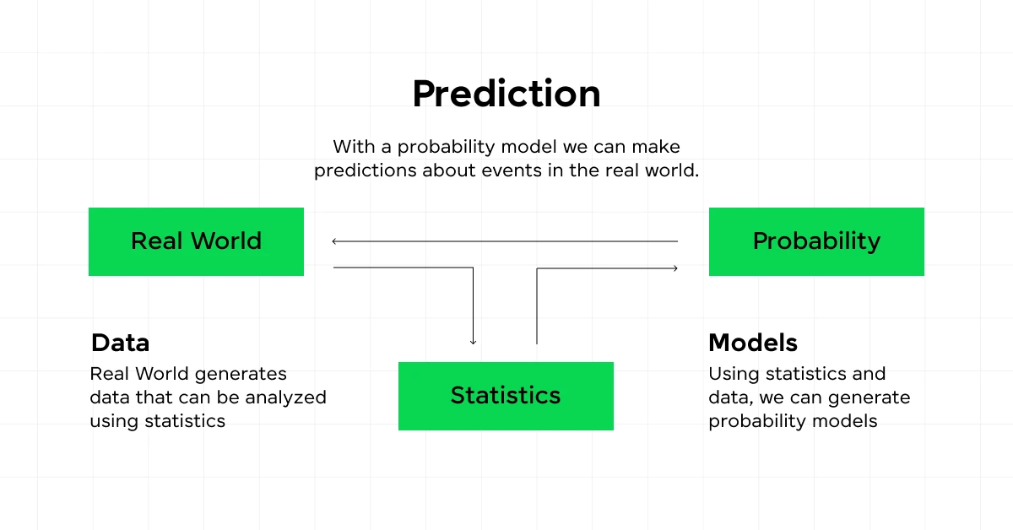
The Shape of Probability
Normal Distribution: The "Bell Curve." Most natural data (like human heights or exam scores) clusters around the middle.
Binomial Distribution: Used for "Yes/No" outcomes (e.g., Did a patient recover? Did a seed sprout?). It models the number of successes in a fixed number of trials.
Poisson Distribution: Models the frequency of events over a fixed period of time or space (e.g., How many cars pass a Charsadda checkpoint per hour?).

Slide 2
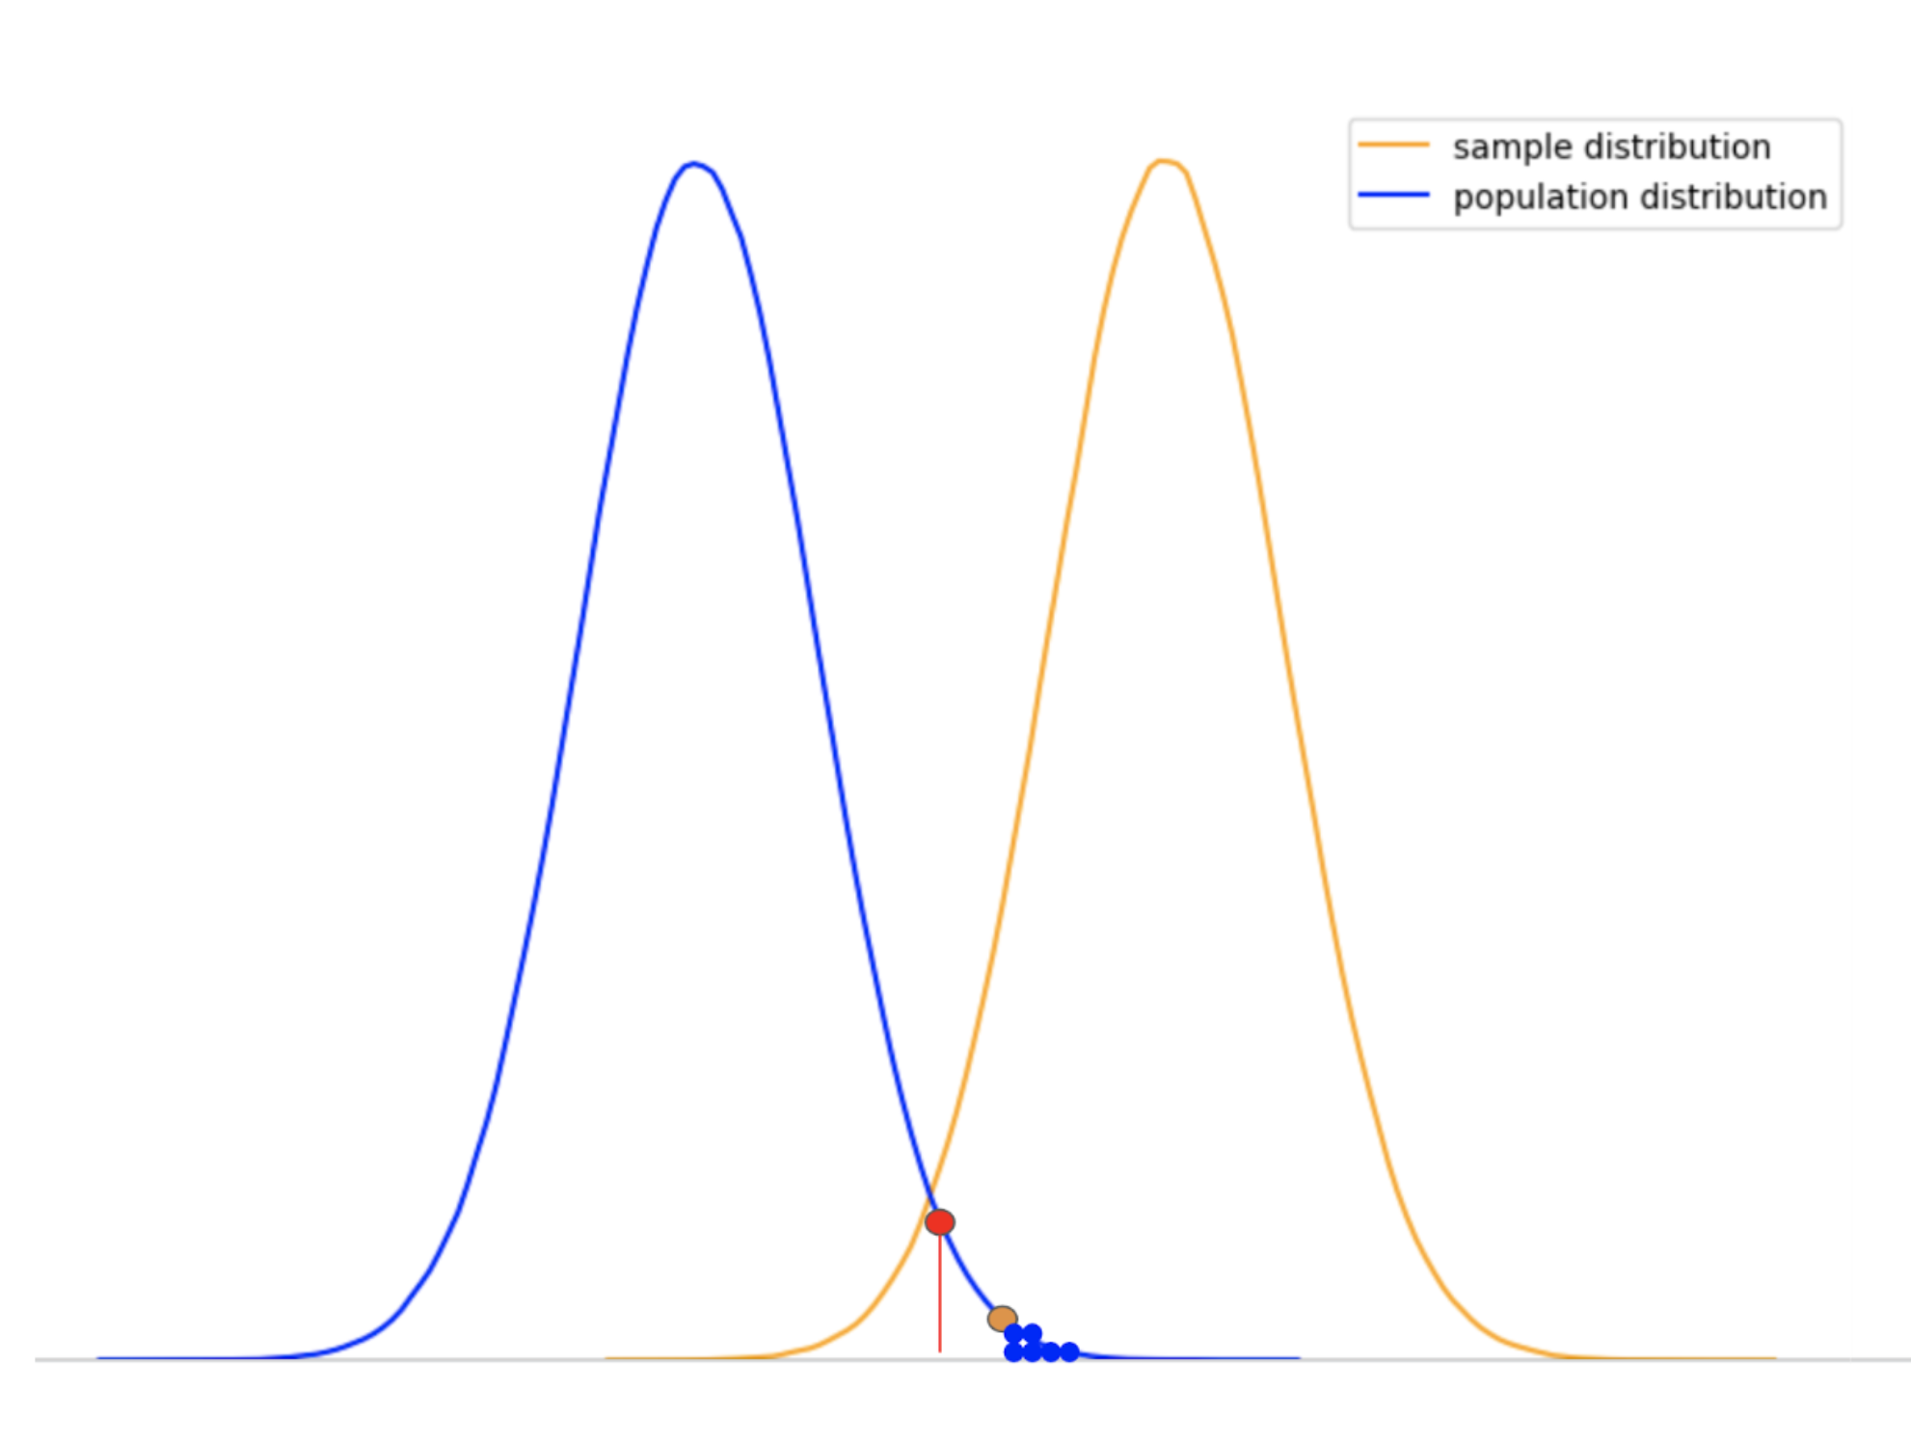
The P-Value – The "Luck" Detector
The Null Hypothesis (H_0): The assumption that "Nothing happened" or "The difference is just luck."
Alpha Level (alpha): Usually set at 0.05. This is our "Doubt Threshold."
The P-Value: The probability that we would see these results if the Null Hypothesis were true.
The Rule: If P < 0.05, we "Reject the Null." We are 95% confident the result is a real trend, not a mistake.

Slide 3
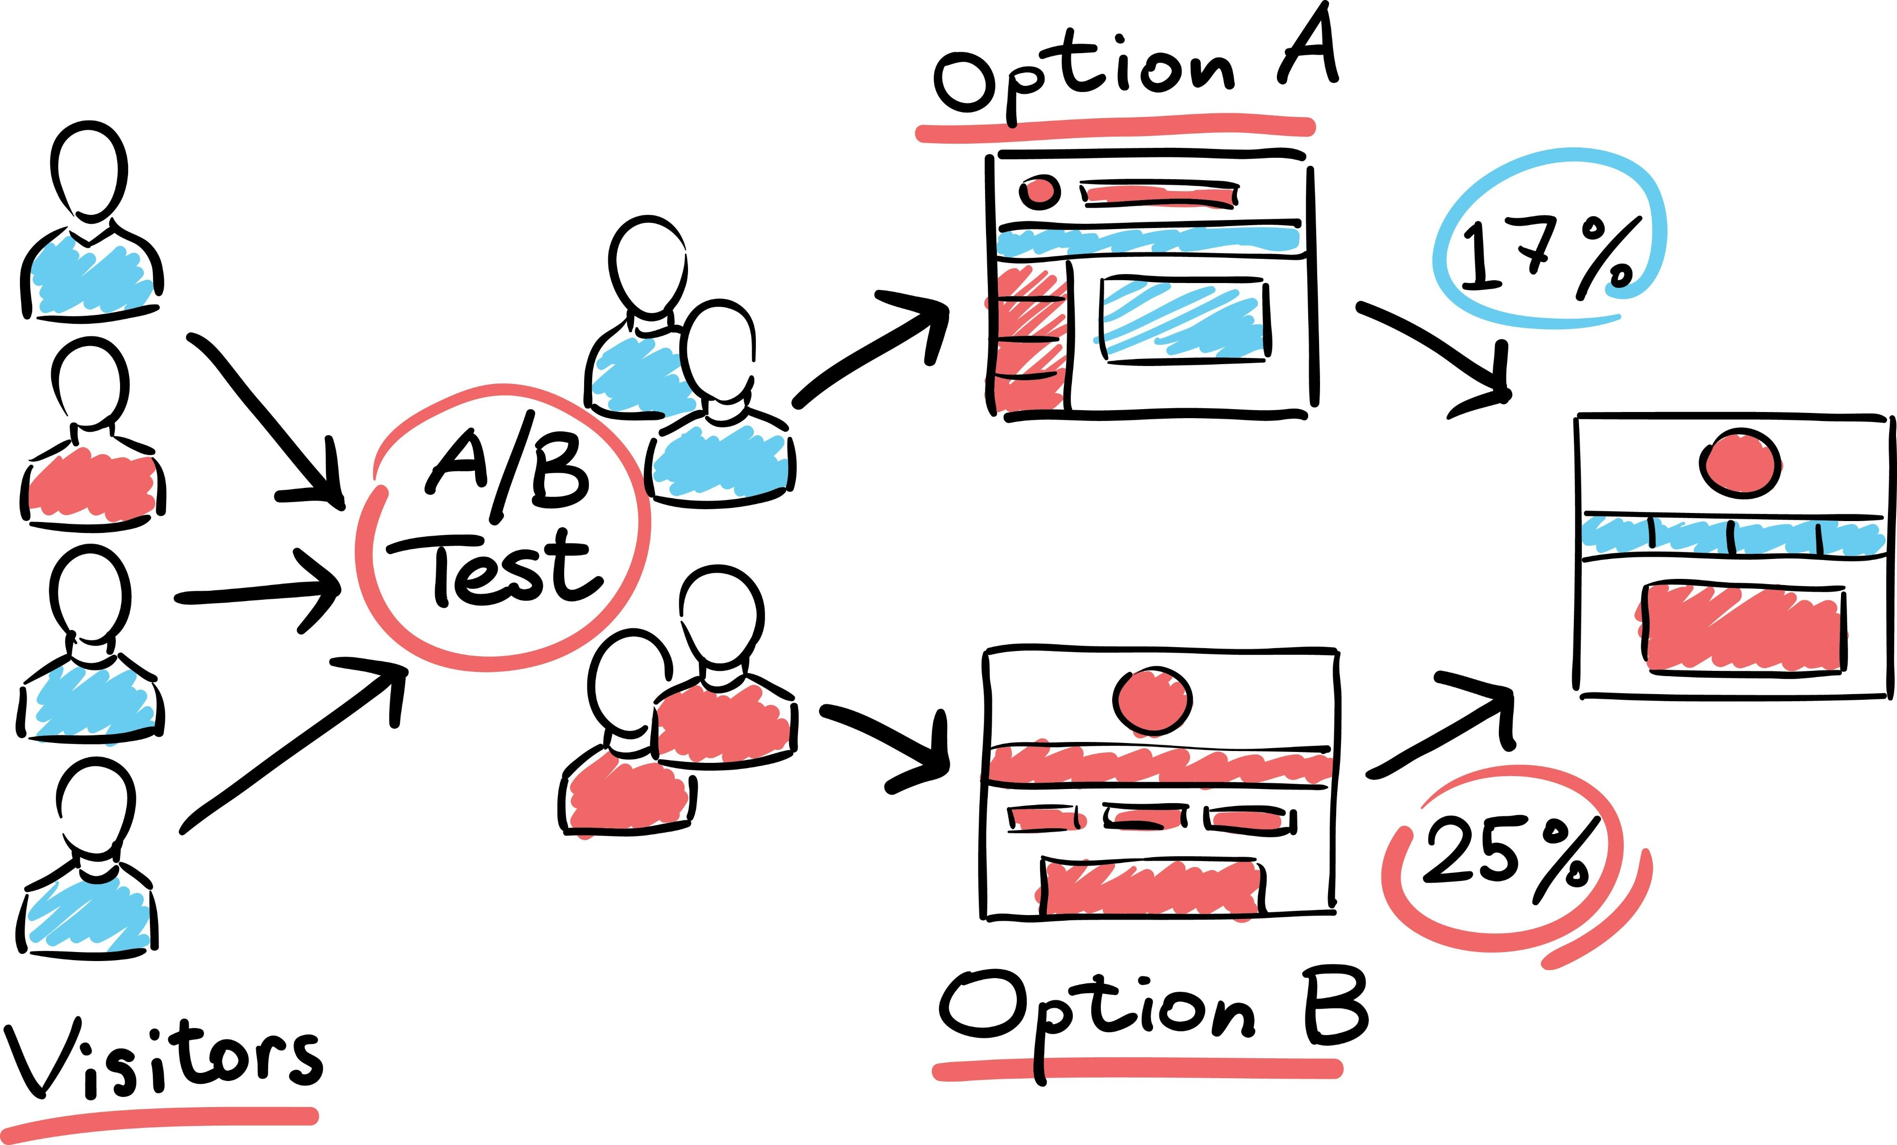
A/B Testing – Experimental Design
The Setup: Splitting a population into two groups: Control (A) and Treatment (B).
The Change: Group B gets a "treatment" (a new medicine, a different fertilizer, or a new website button).
The Measurement: We use statistical tests to see if the difference in performance between A and B is large enough to be meaningful.
Industry Standard: This is how companies like Facebook, Google, and Amazon make every single design decision.

